Slide 1
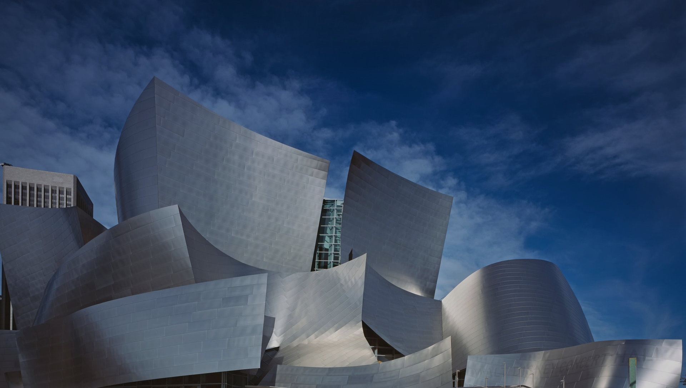
Architecture & Infrastructure As Code

Slide 2








About me
Christian Eder
35 years
Father of my 2 years daughter
→ just a little bit sleepy today ☺
@_ceder
https://github.com/ChristianEder

Slide 3
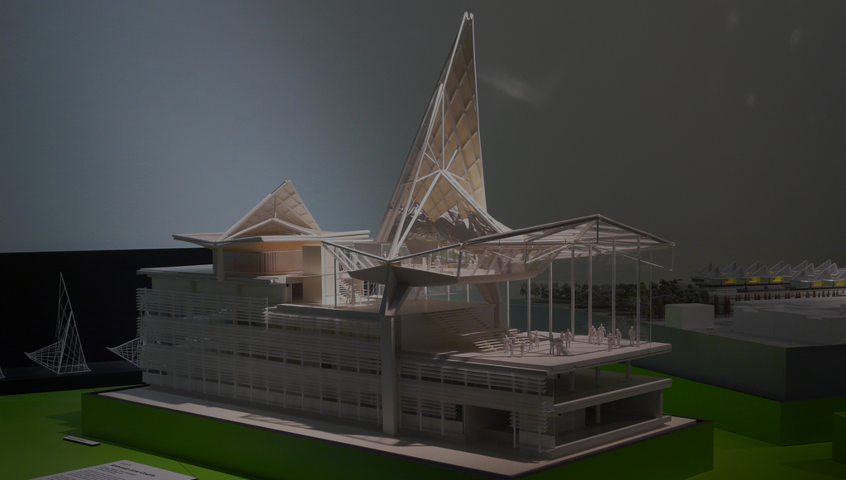
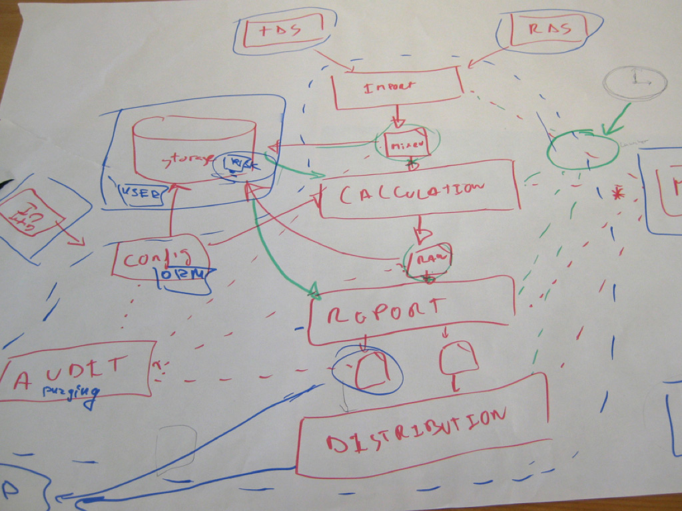
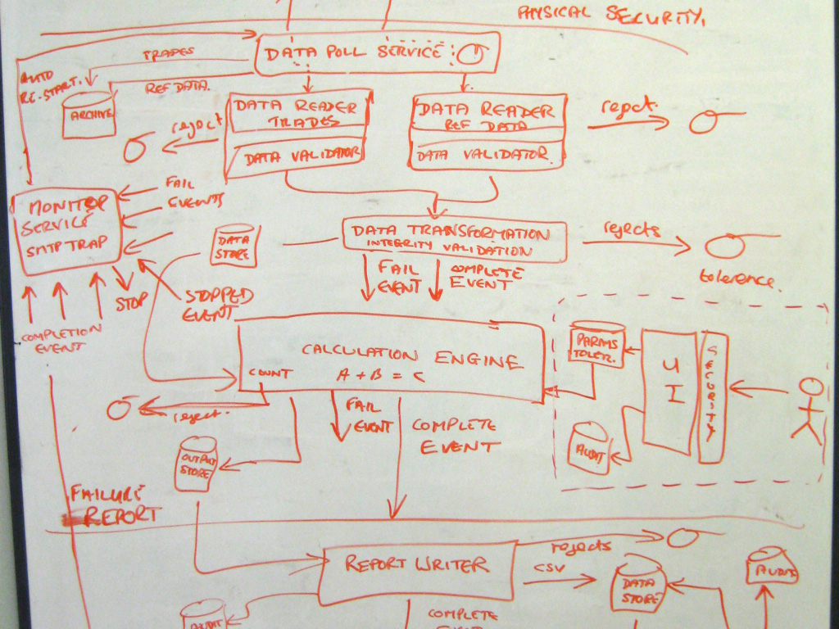
The model code gap
What does this model have in common with most software architecture models?
Doesn’t show a lot technical detail
But at least its beautiful ;-)
Most likely will never get updated when the actual thing is being built
The end result will look alike, but not the same

Slide 4
The model code gap
Models are everywhere in software development
Implementation
User and Business Requirements
Operations
Architecture
Software Product
Customer

Slide 5
The model code gap
When models don’t show the same things
Implementation
→ Code
Operations
Architecture
→ Diagrams & Documents
→ Infrastructure

Slide 6
The model code gap - effects
Architectural
Erosion
Risk of delivering “the wrong thing”
↑
Maintainability
↓
Meeting non functional requirements
↓
What could go wrong?
Notes:
Maintainability:
- Documenation & Code mismatch -> onboarding harder
NFR:
- Designed to support NFRs, but not implemented

Slide 7

Architecture Model
We all know & fear architecture models like these
But at least its beautiful ;-)
Most likely will never get updated when the actual thing is being built
The end result will look alike, but not the same

Slide 8
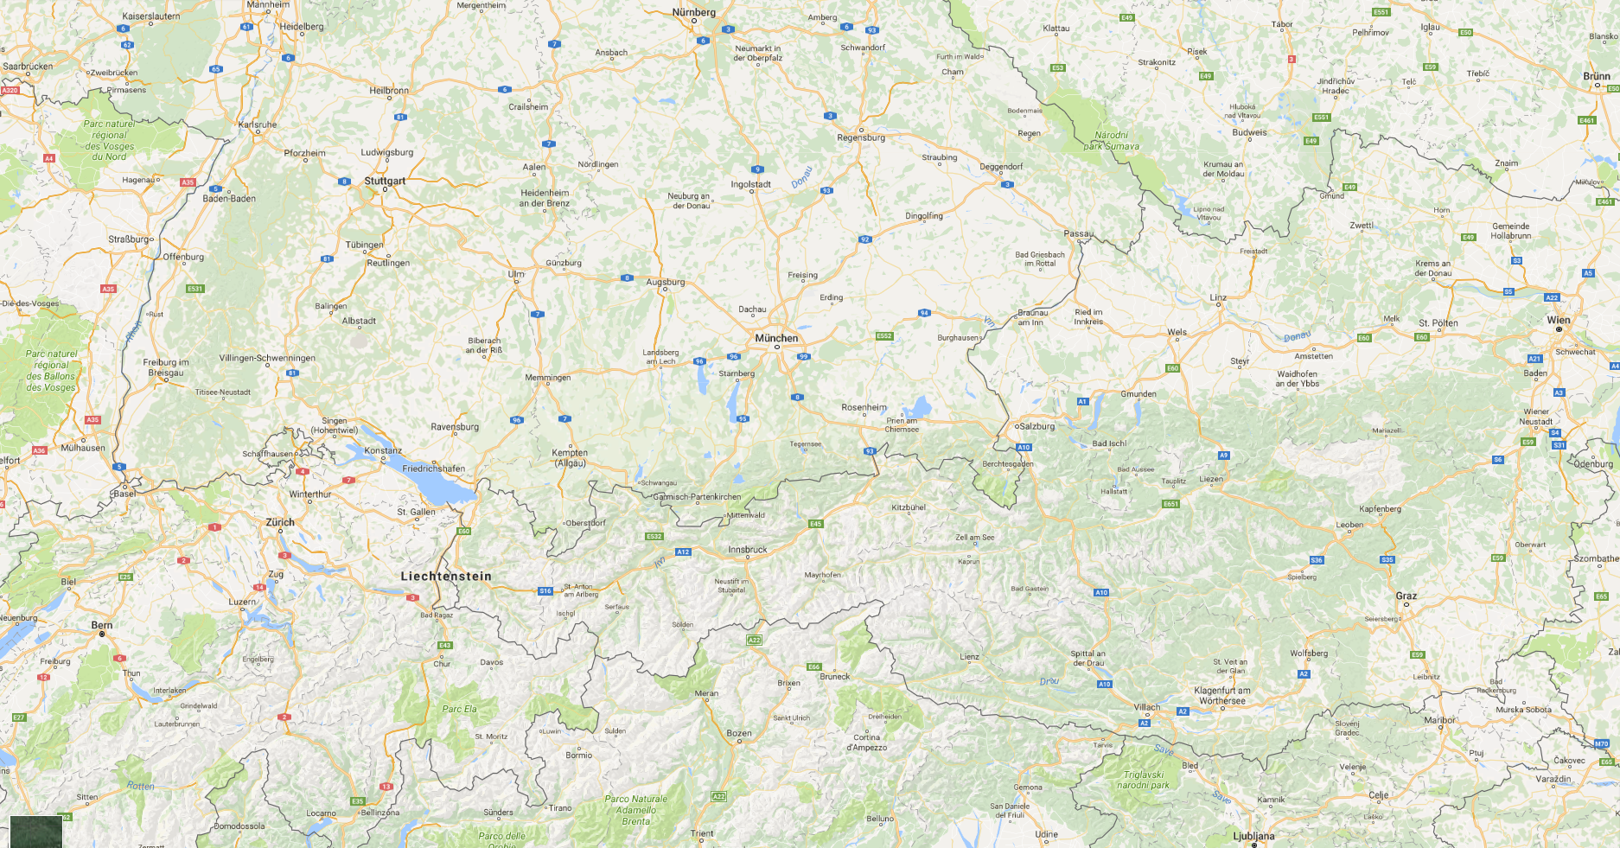
Simon Browns C4 Architecture Model
“Diagrams are maps”
System Context, Containers, Components, Classes
http://simonbrown.je
http://www.codingthearchitecture.com

Slide 9


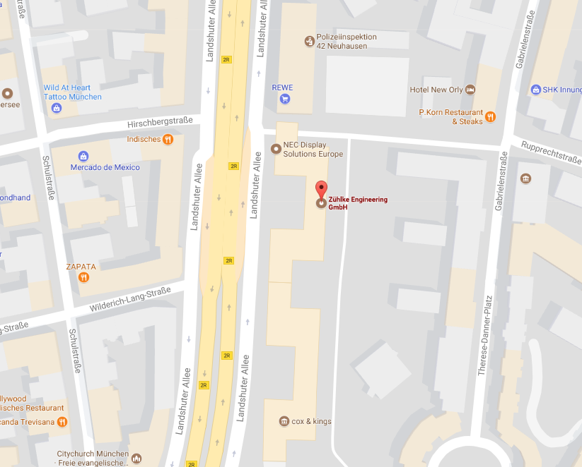
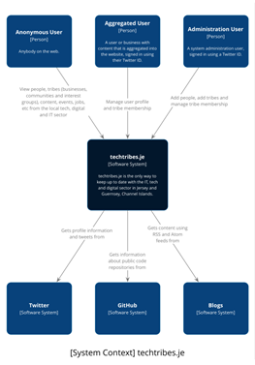
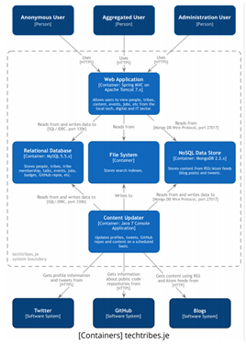
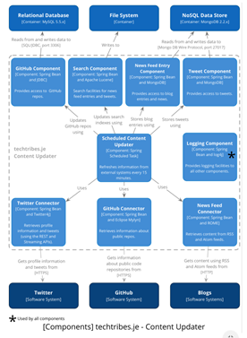
Simon Browns C4 Architecture Model
“Diagrams are maps that help you navigating”

Slide 10
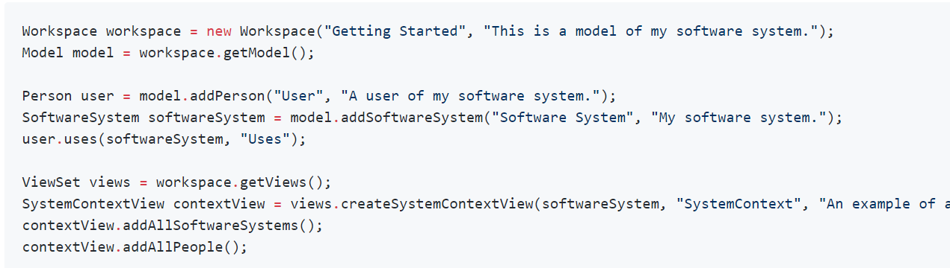
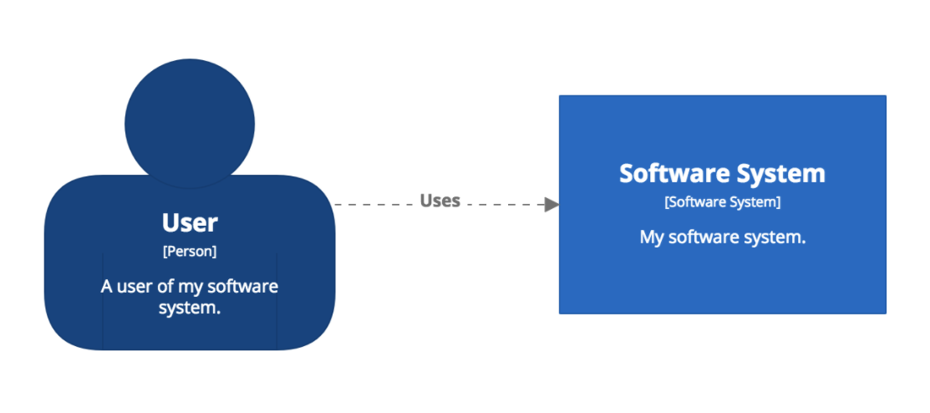
Simon Browns Structurizr
Create software architecture models based upon the C4 model using code

Slide 11

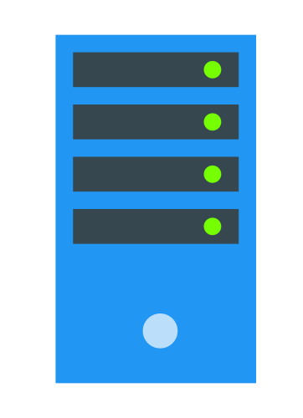


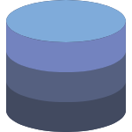

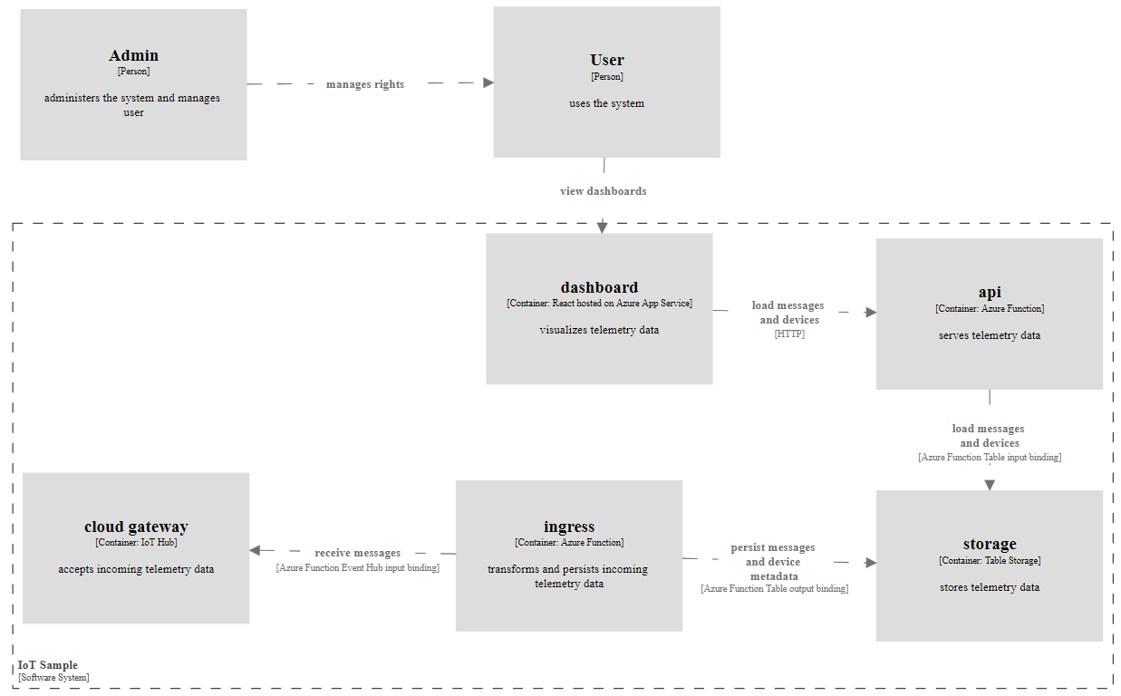
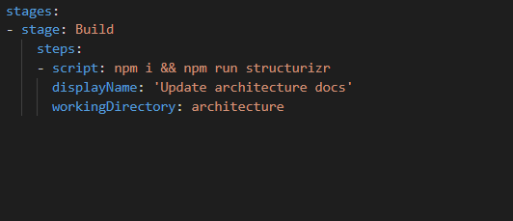
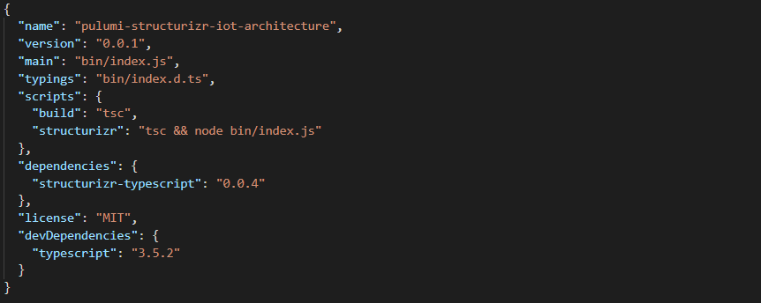
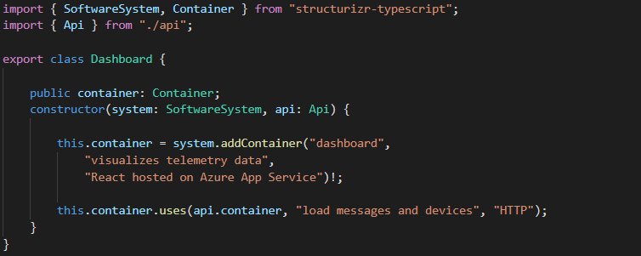
Architecture as Code
Using Structurizr – SDKs are available for Java, C# and TypeScript

Slide 12



“Infrastructure” as code
“Infrastructure” ≈ “Something that allows to run code or store data”
IAAS
PAAS
FAAS
Azure Virtual machines
AWS EC2
Azure App Services
AWS Elastic Beanstalk
Azure Functions
AWS Lambda
Azure wording: “Resources”
AWS wording: “Services”
Wording for this talk: “Infrastructure”

Slide 13
Infrastructure as code
Applying software development principles to cloud infrastructure deployment
Code
Push
Build &
Deploy

Slide 14
Infrastructure as code
There are a lot of tools to automate deploying cloud infrastructure
Tools provided by the cloud providers
Azure Resource Manager: JSON files, PowerShell, az CLI
AWS Cloud Formation: YAML files
Google Cloud Platform Deployment Manager: YAML files
Cloud agnostic tools
Terraform: custom DSL with cloud-specific providers
pulumi: TypeScript, Golang, Python

Slide 15
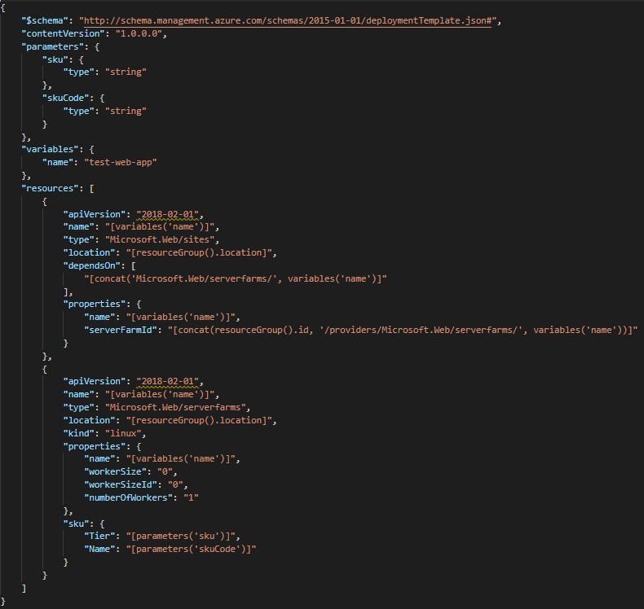
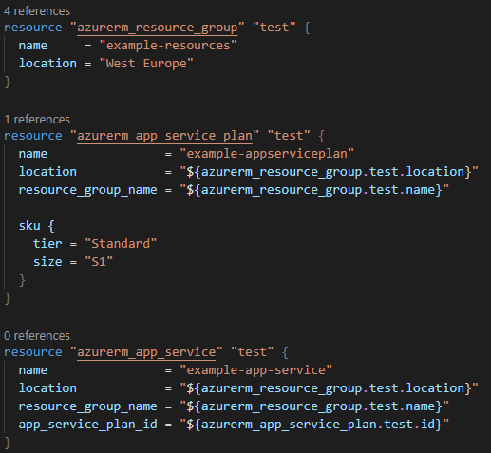
Infrastructure as Code
There are a lot of tools to automate deploying cloud infrastructure
Azure Resource Manager
Terraform

Slide 16
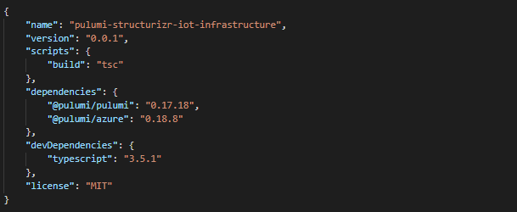
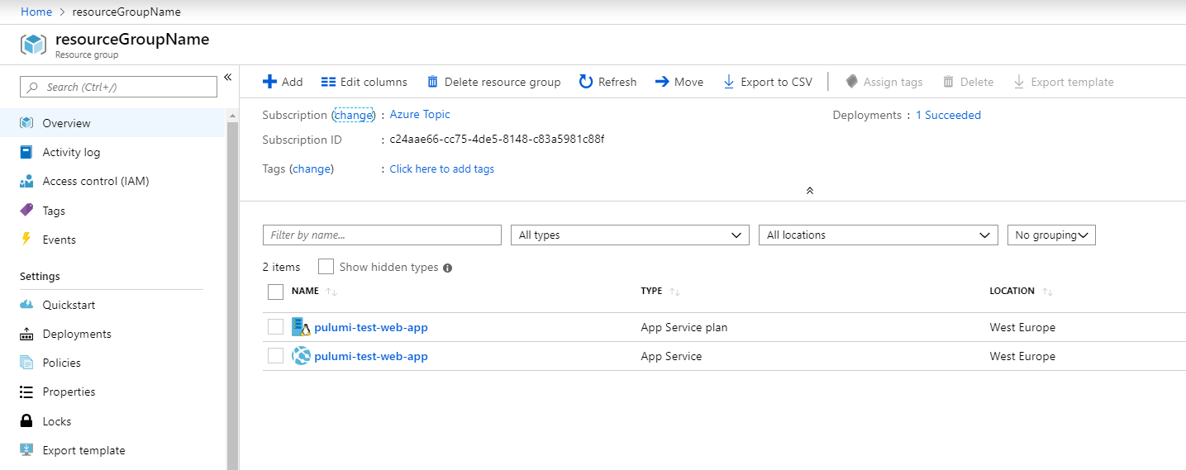
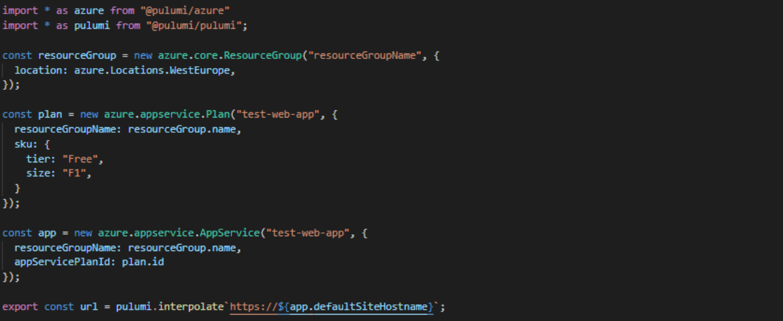
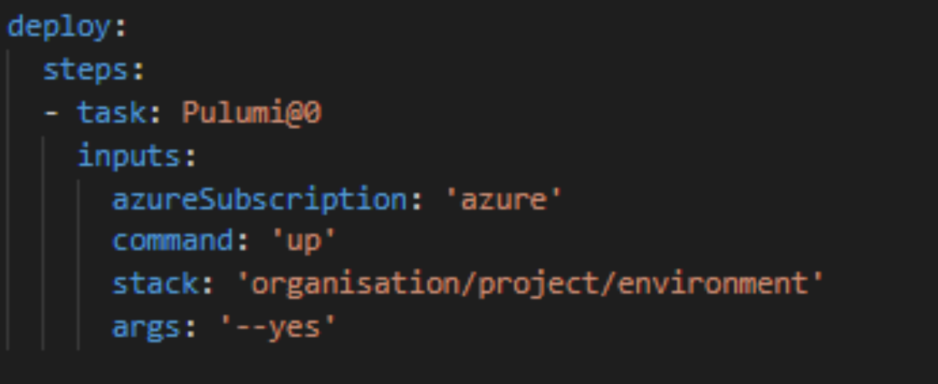
Infrastructure as Code
Using pulumi

Slide 17
Infrastructure & architecture as code
Using pulumi & structurizr
https://github.com/ChristianEder/pulumi-structurizr-iot
https://github.com/ChristianEder/pulumi-structurizr-workshop/tree/master/examples/getting-started/pulumi-and-structurizr

Slide 18

Recap
Code the architecture
→ Structurizr is easy and
free to start with
Start small
The example shown
today can be found at
https://github.com/ChristianEder/pulumi-structurizr-iot
Code the infrastructure
→ Start with the language you know best – TypeScript, Powershell, C#...

Slide 19

Thank you for listening – any questions?
@_ceder
https://github.com/ChristianEder
No? then lets get started with the workshop

Slide 20


Infrastructure & architecture as code
Now: Hands On!
https://github.com/ChristianEder/pulumi-structurizr-workshop
… or follow the steps on the handouts to connect via RDP to pre-configured VMs

Slide 21
Infrastructure & architecture as code
Now: Hands On!
Handout:
On your machine, connect to the VM using the URL and credentials on your handout via RDP
Open a powershell window inside the VM (Windows-Key → “Powershell” → Enter)
Execute the following commands:
cd C:\repos\pulumi-structurizr-workshop
Set-ExecutionPolicy RemoteSigned
.\scripts\finalize-vm-setup.ps1
code .

